Slide 1

MGN-502
Decision Making
Presented by
P.B.Narendra Kiran - M.B.A., M.Phil., (Ph.D.)

Slide 2

At the end of this lecture, you will be able to-
Apprehend Decision making process
Importance of Decision Making
Types of Decision Making
Style of Decision Making
Decision Making Tools

Slide 3
DECISION MAKING
“A decision is a judgement. It is a choice between alternatives. It is rarely a choice between right and wrong. It is at best a choice between “almost right” and “probably wrong”.-Drucker
“A manager by profession is a decision maker; Uncertainty is his opponent, overcoming it is his mission.”

Slide 4
Definition of Decision Making
“Decision-making involves the selection of a course of action from among two or more possible alternatives in order to arrive at a solution for a given problem”

Slide 5

Decision Making
Decision making is not easy
It must be done amid
  ever-changing factors
  unclear information
  conflicting points of view

Slide 6
Decisions and Decision Making
Decision = choice made from available alternatives
Decision Making = process of identifying problems and opportunities and resolving them

Slide 7
Concept of Decision Making
There are innumerable decisions that are taken by human beings in day-to-day life.
Managerial functions like planning, organizing, staffing, directing, coordinating and controlling are carried through decisions.
Decision making is possible when there are two or more alternatives to solve a single problem or difficulty.

Slide 8
The Significance of Decision Making
Decision making is the one truly distinctive characteristic of managers.
Decisions made by top managers commit the total organization toward particular courses of action.

Slide 9
The Significance of Decision Making (cont’d)
Decisions made by lower levels of management implement the strategic decisions of top managers in the operating areas of the organization.
Decisions invariably involve organizational change and the commitment of scarce resources.

Slide 10

Categories of Decisions/Types
Programmed Decisions (routine, almost automatic process)
  Situations occurred often enough to enable decision rules to be developed and applied in the future (There are rules or guidelines to follow)
  Made in response to recurring organizational problems (managers have made decision may times before)
  Example: deciding to reorder office supplies

Slide 11
Non-programmed Decisions – (Unusual situations that have not been often addressed)
In response to unique, poorly defined and largely unstructured, and have important consequences to the organization
No rules to follow, since the decision is new
These decisions are made based on information, and a managers intuition and judgment
Example: should the firm invest in a new technology?

Slide 12
The Decision-Making Process
Define the problem/ Setting
managerial
Objectives by identifying the
Limiting factors
Searching
For potential
alternatives
Comparing &
evaluating
alternatives
Revise or update objectives/problem
Renew
search
Follow-up
and
control
Implementing
decisions
The act
of choice/select the best alternative
Take
corrective
action as necessary

Slide 13

1.Define the problem
Identify the problem
Define the problem
Identify the problem separately from its symptoms (A successful manager doesn’t just attack symptoms; he works to uncover the factors that cause these symptoms )

Slide 14
Eg: Symptoms and their real causes
Symptoms | Underlying Problems
Low profits/declining sales | Poor market research
High cost | Poor design process, poorly trained employees
Low morale | Lack of communication between management and subordinates
High employee turnover | Rate of pay too low, job design not suitable
High rate of absenteeism | Employees believe that they are not valued

Slide 15
Identifying the limiting factor
Realistically, managers operate in an environment that normally doesn’t provide ideal resources.
For example- they may lack the proper budget or may not have the most accurate information or extra time. So they must choose to satisfy - to make the best decision possible with the available information, resources and time.

Slide 16
2.Develop potential alternatives
A manager should think through and investigate several alternatives solutions to a single problem before making a quick decision. one of the best methods for developing alternatives is through brainstorming(where a group works together to generate ideas and alternative solutions)

Slide 17
Although brainstorming is the most common technique to develop alternative solutions, managers can use several other ways to help develop solutions. Here are some examples-
nominal group technique (it’s a structured meeting, with an agenda, restricts discussion during the decision making process)
Delphi technique- ( participants never meet, but a group leader uses written questionnaire to conduct the decision making

Slide 18

Advantages of group decision making
>Groups provide a broader perspective
>Employees are more likely to be satisfied and
to support the final decision
>opportunities for discussion help to answer
questions and reduce uncertainties for the
decision makers.

Slide 19
3. Analyze the alternatives
>Decide the relative merits of each idea
>Identify the advantages and disadvantages of each
alternative solutions
>Perform a cost benefit analysis for each alternative
>Rank/give weights/ to each alternative
>A manager needs to evaluate each alternative in terms of-
Feasibility (can it be done)
Effectiveness (how well does it resolve the problem situation?)
Consequences ( what will be its cost to the organization?)

Slide 20
4. Select the best alternative
Decides which alternative is-
the most feasible and effective
less cost to the organization
chances of success
A manager simply selects the alternative with
the highest probability of success

Slide 21
5. Implement the decision
6. Establish a control- Actions needs to be monitored. An evaluation system should provide feedback on how well the decisions is being implemented, what are the results, what adjustments are necessary to get the results etc…

Slide 22
Decisions and Decision Making
Many decisions that managers deal with every day involve at least some degree of uncertainty and require non-programmed decision making
  May be difficult to make
  Made amid changing factors
  Information may be unclear
  May have to deal with conflicting points of view

Slide 23
Conditions that influence decision making
Certainty
  all the information the decision maker needs is fully available ( DSS)
Risk
  Non programmed decisions are tailored to the situations
  Lacks complete information
  future outcomes associated with each alternative are subject to chance
Uncertainty
  Sometimes cant even assign probabilities
  information about alternatives and future events is incomplete
  managers may have to come up with creative approaches to alternatives
Ambiguity
  by far the most difficult decision situation
  goals to be achieved or the problem to be solved is unclear
  alternatives are difficult to define
  information about outcomes is unavailable

Slide 24
Conditions that Affect the Possibility of Decision Failure
Organizational
Problem
Low
Possibility of Failure
High
Certainty
Risk
Uncertainty
Ambiguity
Programmed
Decisions
Nonprogrammed
Decisions
Problem
Solution

Slide 25
Increasing Participation in Decision Making
Advantages | Disadvantages
1) Broader perspective for problem definition and analysis. 2) More knowledge, facts, and alternative can be evaluated. 3) Discussion clarifies ambiguous problems and reduces uncertainty about alternatives. 4) Participation fosters member satisfaction and support for decision. | Time-consuming; wasted resources if used for programmed decisions. 2) Compromise decisions may satisfy no one. 3) Groupthink – group norms may reduce dissent and opinion diversity. 4) No clear focus for decision responsibility.

Slide 26
Problem solving and Decision Making
Basis of Difference | Problem Solving | Decision Making
1) Focus | Problem solving consists in looking at the potential causes of the problem. | Decision making consists in the method of approaching to resolve the problem.
2) Nature | Problem solving consists in jotting down the description of the various causes of the problem in terms of question such as where, how, with whom and why. | Decision making is all about finding solutions to all these questions such as how, where, with whom and why through the forming a plan that has to be implemented.
3) Concept | Problem solving itself is an experience to be undergone in every corporate establishment. | Decision making on the other hand is the consideration of what is learned from problem solving.
4) Direction | Problem solving is concerned with looking back, this is the way it should be and it no longer is. | Decision making is concerned with future consequences; it changes the environment and the situation.
5) Approach | A problem is solved now so that decision making is needed later. This is because the problem solving approach has restored the process where it should be. | A decision is made to create a change and therefore generates a new set of circumstances. Decision making focuses on making things happen in future.

Slide 27
Challenges & Problems
in Decision Making
The tendency to respond to the problem instantaneously without proper information and thinking.
The tendency of human-beings to evaluate a given problem with pre-conceived notions acts as a stumbling block in understanding the real situation.
The tendency to resist new and innovative solutions. This is known as the love for ‘status-quo’.

Slide 28
SUGGESTIONS
Avoid premature evaluation.
Initiate impartial probing by avoiding personal bias on the outcome.
Develop a sound system that can supply adequate information for making decisions.
Encourage group leaders to respond to a given situation and compare the pros and cons of the solutions offered by the two groups for making an effective decision.
Encourage innovative thinking among the subordinates so as to identify the crux of the problem without waste of time and money.
When decisions of critical and pivotal in nature are to be taken, encourage group thinking. For this, the problem is to be presented to the group members first and they are asked to develop as many solutions as possible in a free environment.

Slide 29
VROOM’S PARTICIPATIVE
DECISION MAKING MODEL
In developing their model Vroom and Yetton made these assumptions:
The Model should be of value to leaders or managers in determining which leadership styles they should use in various situations.
No single leadership style is applicable to all situatuions
The main focus should be the problem to be solved and the situation in which the problem occurs.
The leadership style used in one situation should not constrain the styles used in other situations.
Several social processes influence the amount of participation by subordinates in problem solving.

Slide 30
Participative Decision Styles
Decide
Consult (Individual)
Consult (Group)
Facilitate
Delegate

Slide 31
UNDERSTANDING THE MODEL
Decision Quality
Subordinate Commitment
Time Constraints

Slide 32


MODEL OF DECISION MAKING
ON GOING / RULES STRUCTURED EMPRICAL
REQUIRES THINKING UN-STRUCTURED NOT UNIQUE
Approach
Type
Knowledge
Probability of risk
Alternatives available
Goals
Rational/Objective
Prescriptive (Idealized situation)
Complete
Low
Many
Defined
Satisficing Approach
Descriptive (Reality Based)
Fragmentary
High
Only a few
Broad Spectrum

Slide 33
Selecting a Decision Making Model
Depends on the manager’s personal preference
Whether the decision is programmed or non-programmed
Extent to which the decision is characterized by risk, uncertainty, or ambiguity

Slide 34
Three Decision-Making Models
Classical Model
Administrative Model
Political Model

Slide 35
Classical Model ( Rational Model)
Logical decision in the organization’s best economic interests
Assumptions
Decision maker operates to accomplish goals that are known and agreed upon
Decision maker strives for condition of certainty – gathers complete information
Criteria for evaluating alternatives are known
Decision maker is rational and uses logic
Normative = describes how a manager should and provides guidelines for reaching an ideal decision

Slide 36
Administrative Model
How nonprogrammed decisions are made--uncertainty/ambiguity
Two concepts are instrumental in shaping the administrative model
  Bounded rationality: people have limits or boundaries on how rational they can be
  Satisficing: means that decision makers choose the first solution alternative that satisfies minimal decision criteria

Slide 37
Administrative Model
How nonprogrammed decisions are made--uncertainty/ambiguity
Managers actually make decisions in difficult situations characterized by non-programmed decisions, uncertainty, and ambiguity
Decision goals often are vague, conflicting and lack consensus among managers;
Rational procedures are not always used
Managers’ searches for alternatives are limited
Managers settle for a satisficing rather than a maximizing solution
intuition, looks to past experience
Descriptive = how managers actually make decisions--not how they should

Slide 38
Political Model
Closely resembles the real environment
Closely resembles the real environment in which most managers and decision makers operate
Useful in making non-programmed decisions
Decisions are complex
Disagreement and conflict over problems and solutions are normal
Coalition = informal alliance among manages who support a specific goal

Slide 39
Characteristics of Classical, Political, and Administrative Decision Making Models
Classical Model Administrative Model Political Model
Clear-cut problem and goals Vague problem and goals Pluralistic; conflicting goals
Condition of certainty Condition of uncertainty Condition of uncertainty/ambiguity
Full information about Limited information about Inconsistent viewpoints; ambiguous
alternatives and their outcomes Alternatives and their outcomes information
Rational choice by individual Satisficing choice for resolving Bargaining and discussion among
for maximizing outcomes problem using intuition coalition members

Slide 40
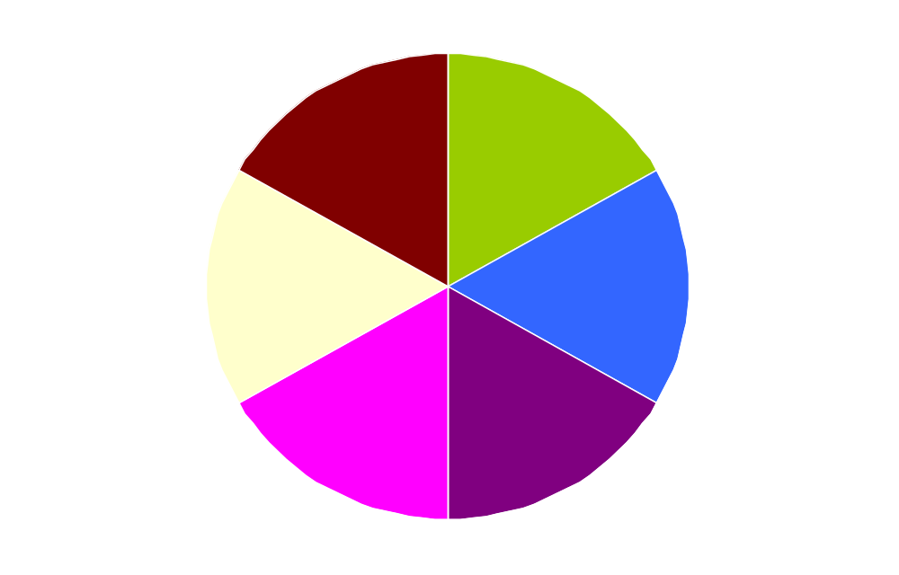
Six Steps in the Managerial
Decision-Making Process
❻
❶
Evaluation
and
Feedback
Recognition of
Decision
Requirement
❷
Implementation
of Chosen
Alternative
Diagnosis
and Analysis
of Causes
Decision-Making
Process
❺
❺
❺
Selection of
Desired
Alternative
Development of
Alternatives
❸
❹

Slide 41
Rational decision making model
Step | Example
Recognizing & defining the situation | A plant manager sees that employee turnover has increased by 5%
Identifying the alternatives | The plant manager can increase wages, increase benefits, or change hiring standards
Evaluating the alternatives | Increasing the benefits may not be feasible. Increasing wages and changing hiring standards may satisfy all conditions
Selecting the best alternative | Changing hiring standards will take an extended period of time to cut turnover, so increase wages

Slide 42

Implementing the chosen alternatives | The plant manager may need permission from corporate headquarters. The HRD establishes a new wage structure
Following up and evaluating the results | The pant manager notes that six months later turnover has dropped to its previous level

Slide 43
CONSTRAINTS OF
RATIONAL DECISION MAKING
PROBLEM
Seldom consensus as to the definition of the problem.
Differentiate fact from opinion.
Identify what standard is violated.
2. GENERATE ALTERNATIVE SOLUTION
The first acceptable solution is usually accepted.
Alternatives are based on what was successful in the past.
Specify alternatives that are consistent with goals

Slide 44
CONSTRAINTS OF
RATIONAL DECISION MAKING
EVALUATE ALTERNATIVES
Limited information available about each alternative.
Satisfactory solutions, not optimal ones, are usually accepted.
Do not evaluate main effects and side effects.
4. IMPLEMENT AND FOLLOW UP
Resistance to change is a universal phenomenon.
Not always clear what part of the solution should be monitored or measured in follow-up.

Slide 45
Decision Styles
Differences among people with respect to how they perceive problems and make decisions
Not all managers make decisions the same
  Autocratic style
  Democratic style
  Participative style
  Consultative style

Slide 46
Personal Decision Framework
Situation:
Programmed/non-programmed
Classical, administrative, political
Decision steps
Personal Decision Style:
Directive
Analytical
Conceptual
Behavioral
Decision Choice:
Best Solution to Problem

Slide 47
The Scope of Decision Making
Individual decision making
Group decision making
Organizational decision making
Metaorganizational decision making

Slide 48
The Scope of Decision Making
Decisional Inputs
(Objectives,
information,
resources,
energy)
Metaorganization
Organization
Interactional
Levels
Group
Individual
Permeable
Boundaries
Decisional
Outputs
(Actions
transactions,
outcomes)
External Environment

Slide 49
New Decision Approaches
for Turbulent Times
New Decision Approaches for Turbulent Times
Practice the Five Whys
Brainstorming
Know When to Bail
Engage in Rigorous Debate
Learn, Don’t Punish

Slide 50
Strategy Formulation
Strategy: a plan of action to achieve one or more long-term or overall goals under conditions of uncertainty.
Strategy formulation: is the process of researching and identifying strategic options, selecting the most promising and deciding how resources will be allocated across the organization to achieve objectives.

Slide 51
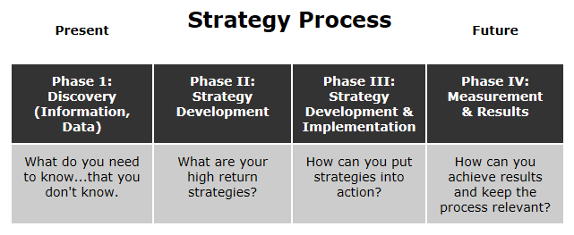
Strategy Process

Slide 52
Strategy Formulation
Strategy: a plan of action to achieve one or more long-term or overall goals under conditions of uncertainty.
Strategy formulation: is the process of researching and identifying strategic options, selecting the most promising and deciding how resources will be allocated across the organization to achieve objectives.

Slide 53

Thank You

